Slide 1
Customized Psychological Diagnosis System (INFLOW)
Your Journey to Know your self
Under the Supervision of: Dr. Mahmoud Wahdan.
Assisted by: Eng. Nadden Ayman.

Slide 2








Our Team
Abdelrahman Ashraf
Othman
Abdelrahman Hossam
Abdelrahman Ibrahim
Abdelrahman Yasser
Mostafa Alaa
Mostafa Badran
Mostafa Gamal Lofty
Mohammed Abdelaziz

Slide 3
02
03
04
What is INFLOW ?
INFLOW Objectives
Why INFLOW?
Similar Projects
01
TOPICS
05
06
07
08
Software
Development
Design
Phase
Analysis Phase
AI Feature & Testing
Strategy

Slide 4
Introduction

Slide 5
What Is INFLOW ?
INFLOW is a Customized Psychological Diagnosis System is platform that enables users to accurately diagnose emotional health conditions, Based on Lüscher Color Test System.
The system is designed to provide users with a comprehensive set of tools to help them better understand their emotional health. It uses a variety of data sources to provide users with detailed information about their emotional health, including symptoms, risk factors, and treatment options.
INFLOW is a Web Application that allow Users to take Lüscher Test , Also it’s mange a Private Psychological clinic, and there is a Mobile Application that help doctor at his work.

Slide 6
INFLOW Objective
INFLOW’s main objective is to make it accessible for any-one to seek help and talk with professional life coaches without feeling wrong.
INFLOW is for user to improve the whole psychological feelings for humans.
INFLOW is for all people not a specific targeted users we all can use it.

Slide 7



Why INFLOW?
Talking with Specialists at the highest level.
Reduce the cost, effort and time.
Giving emotional support to all who needs it.
Confidentiality of the user's data, for each user.

Slide 8
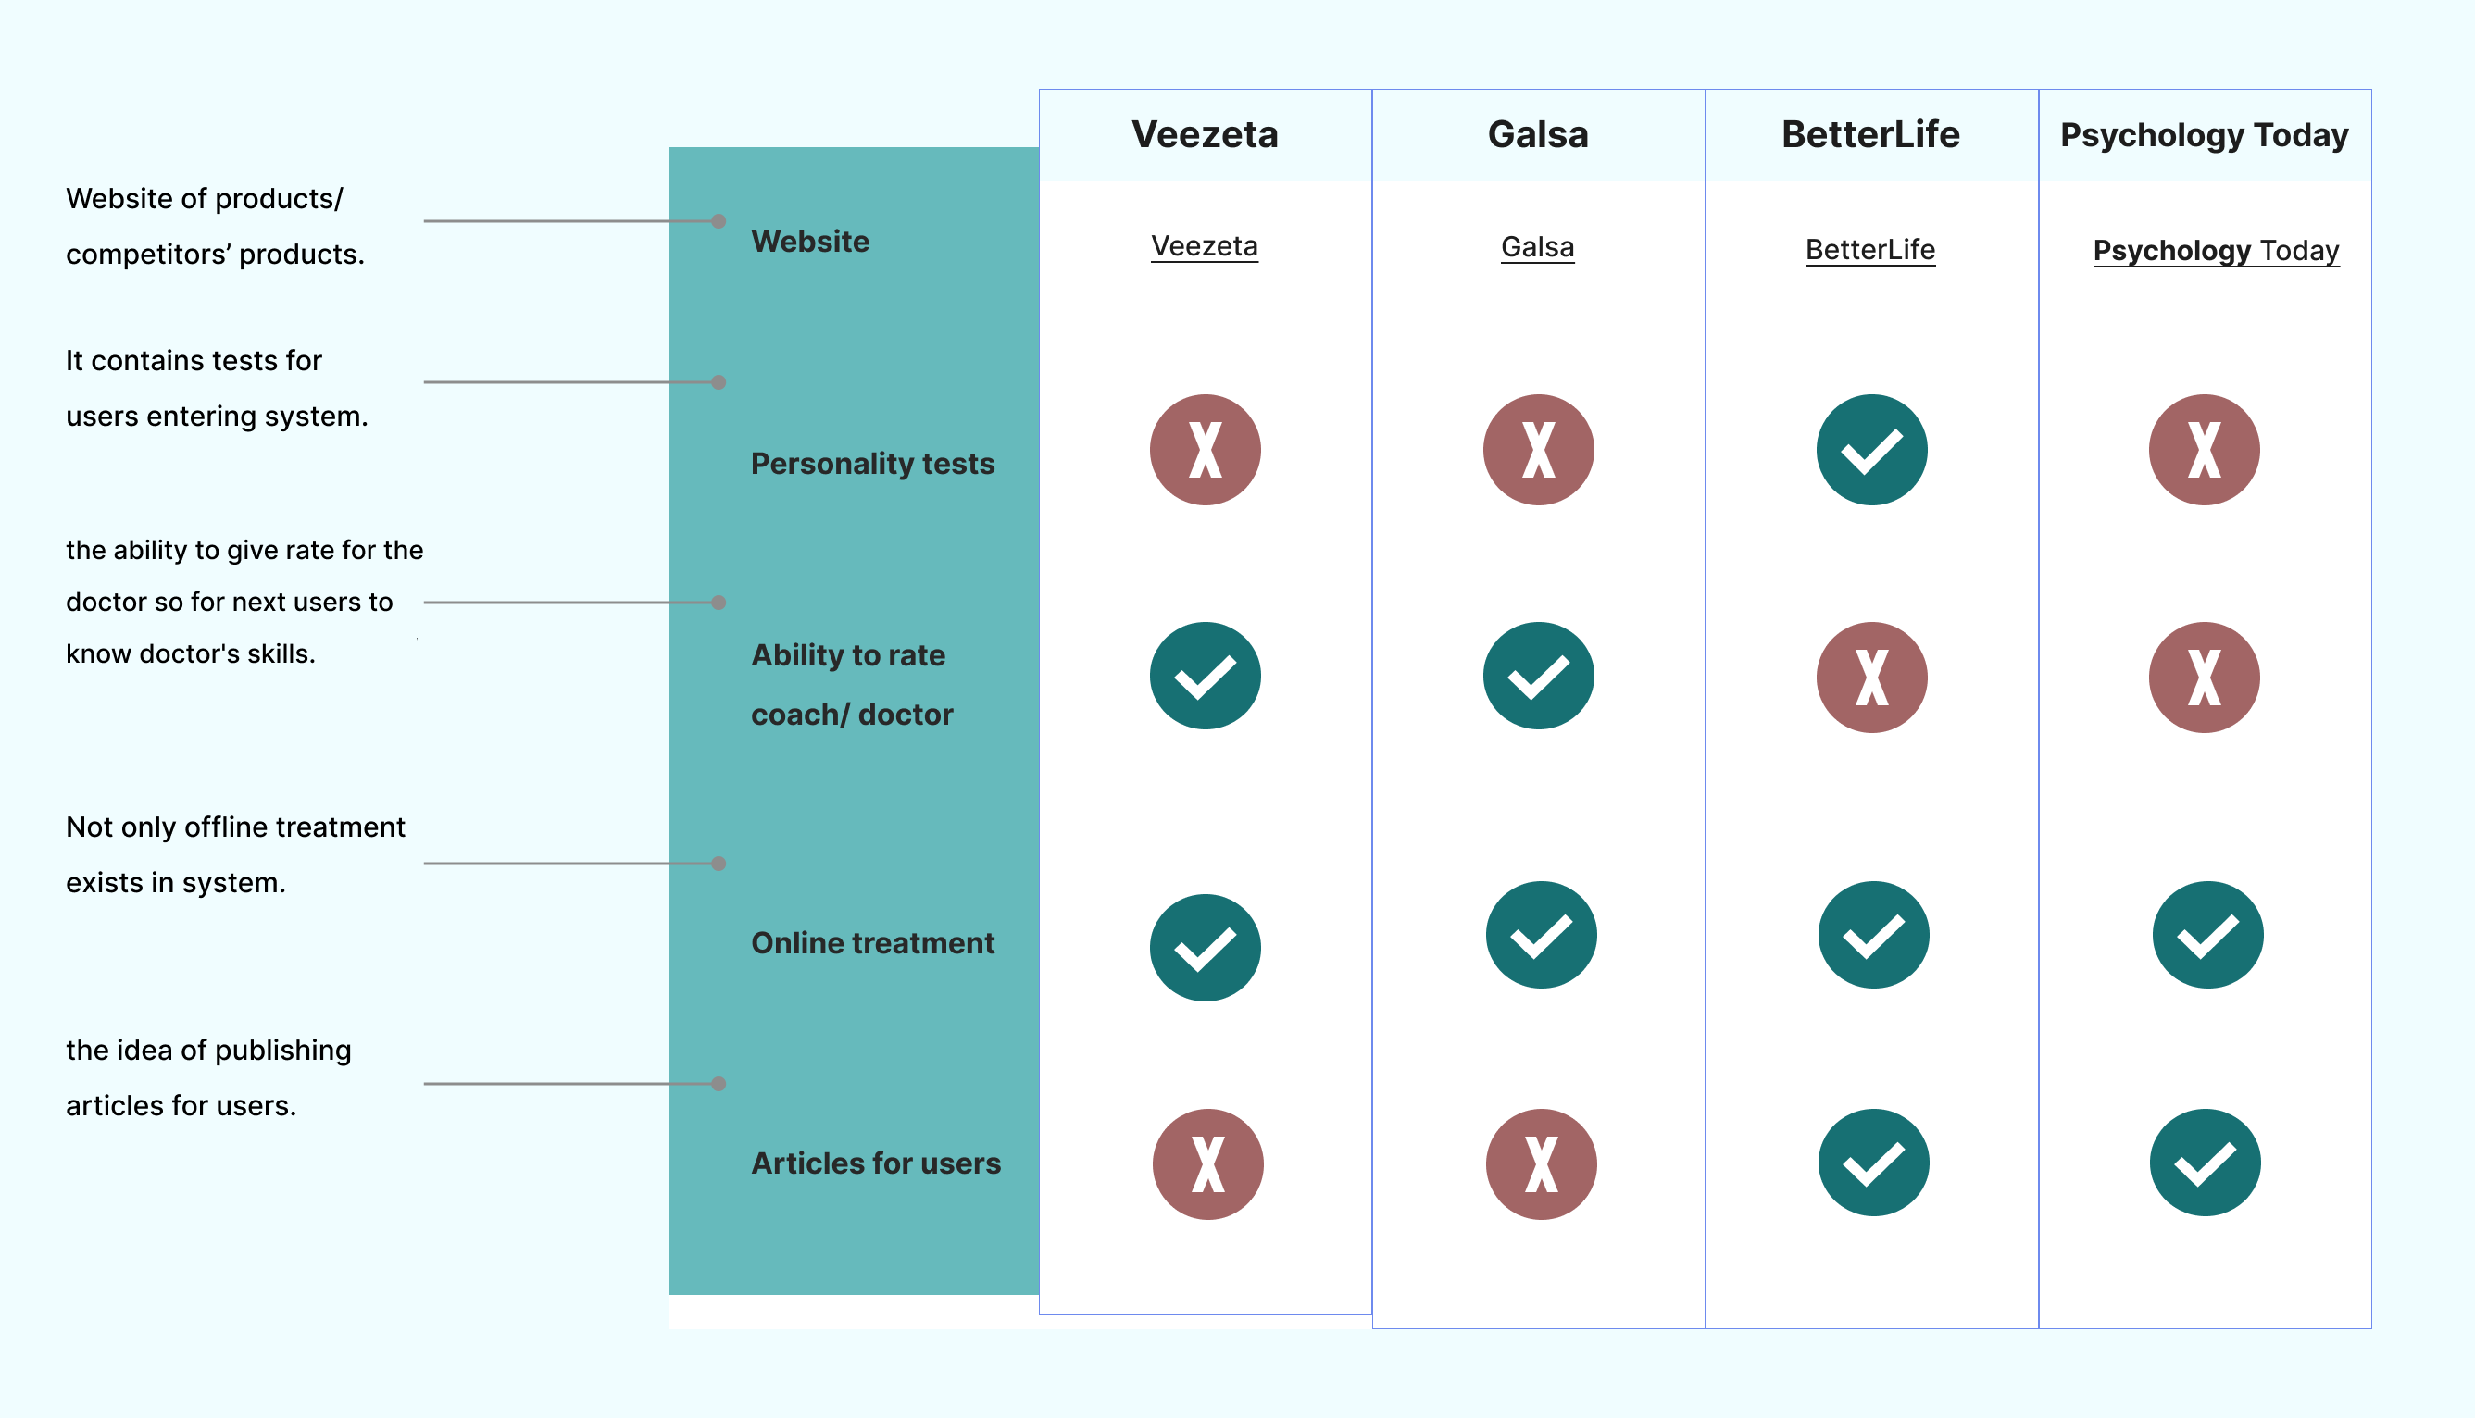
Similar Projects

Slide 9
TOOLS

Slide 10



Tools
Front End Tools
Back End & Testing Tools
AI & Data Analysis Tools
Mobile
Development Tools

Slide 11






Front End Tools
Figma
HTML
CSS
JAVA Script
MUI
React

Slide 12






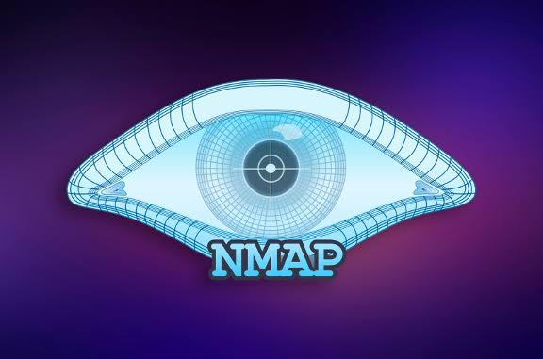
Back End & Testing Tools
PHP
MySQL
Laravel
Jira
Postman
Kali Linux
NMAP

Slide 13


Mobile Development Tools
Android Studio
Kotlin

Slide 14


AI & Data Analysis Tools
Python
Streamlit

Slide 15
Software Development processes

Slide 16
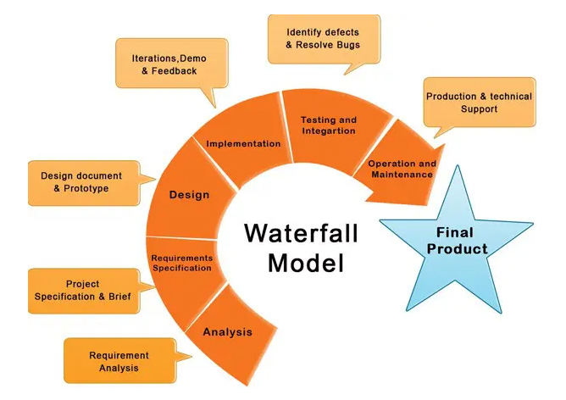
Methodology
In this project we follow the Waterfall
Development Methodology which
follows seven phases:
Requirements
Analysis.
Design.
Coding and implementation.
Testing.
Operation and deployment.

Slide 17
Analysis Phase

Slide 18


Analysis Phase
Data Flow Diagram
Use Case Diagram
Class Diagram

Slide 19
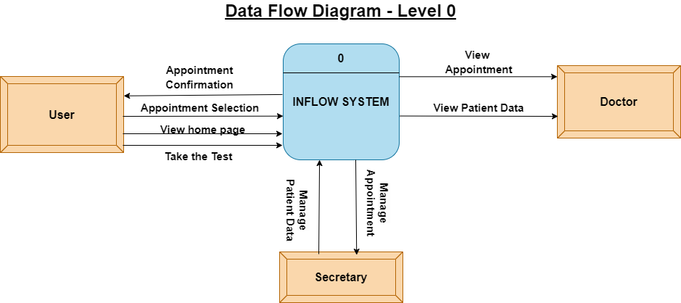
Data Flow Diagram
Context Level

Slide 20
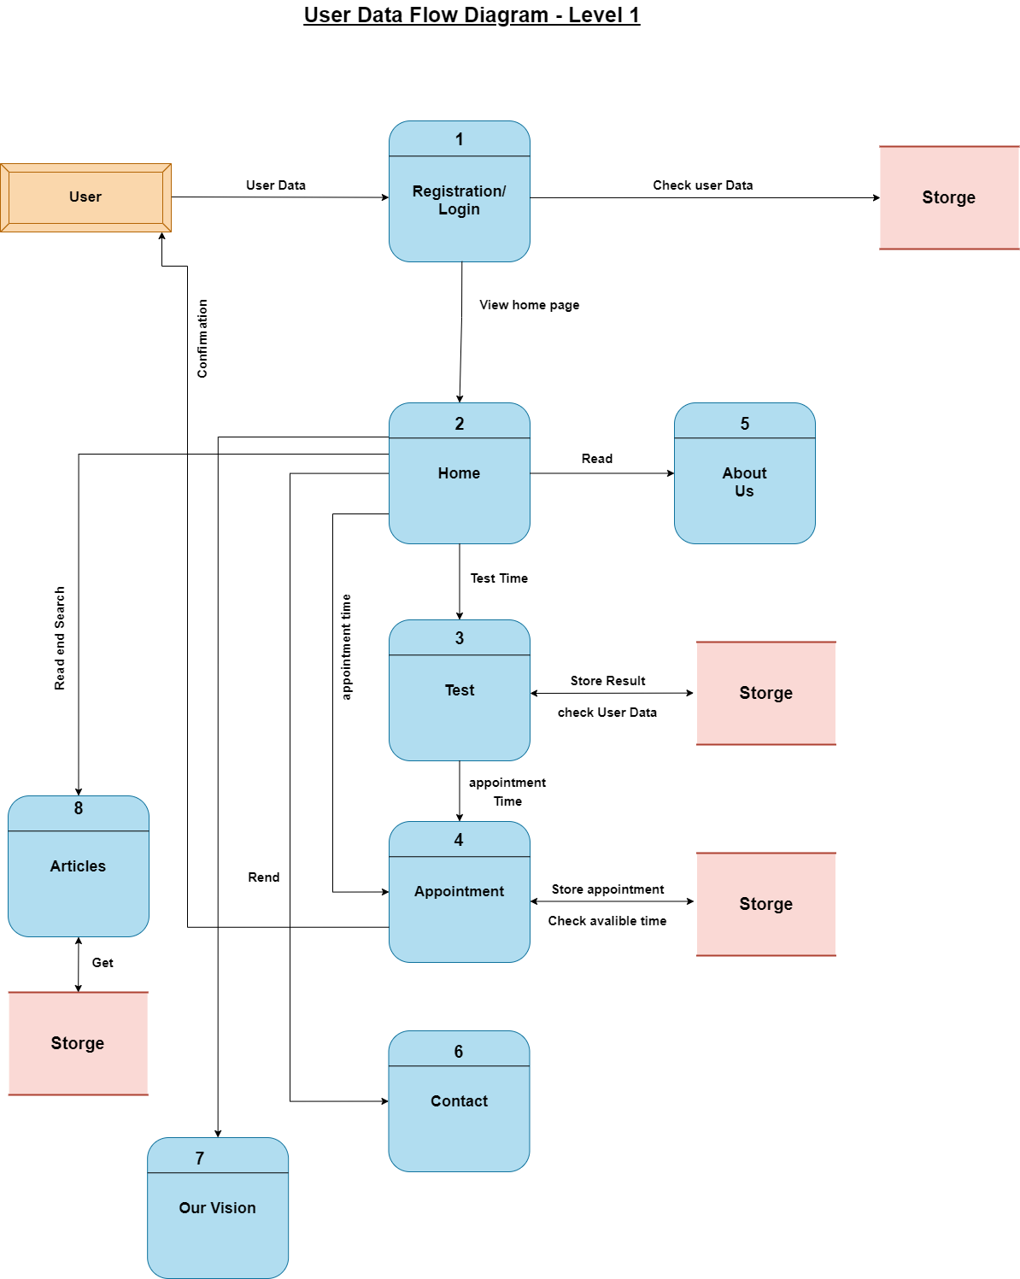
Level 1 (User)
Read

Slide 21
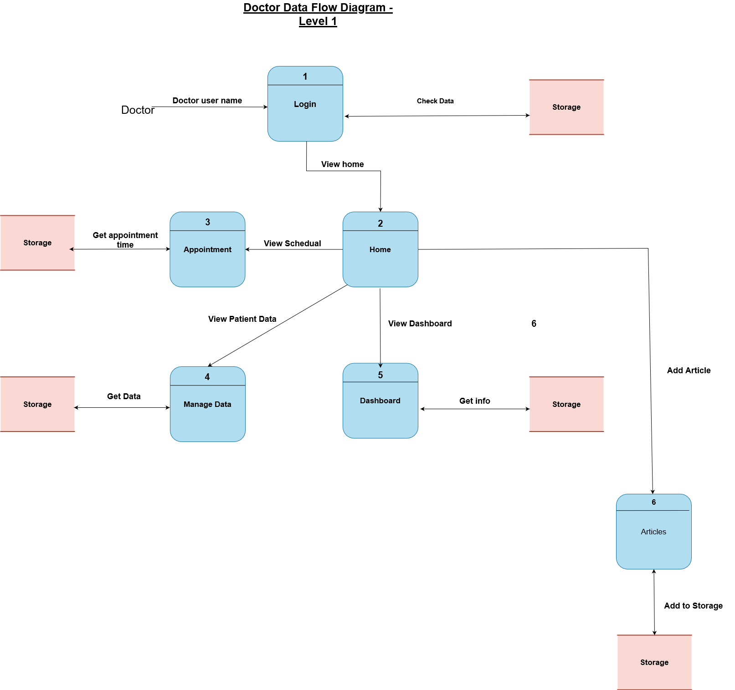
Doctor
Level 1 (Doctor)

Slide 22
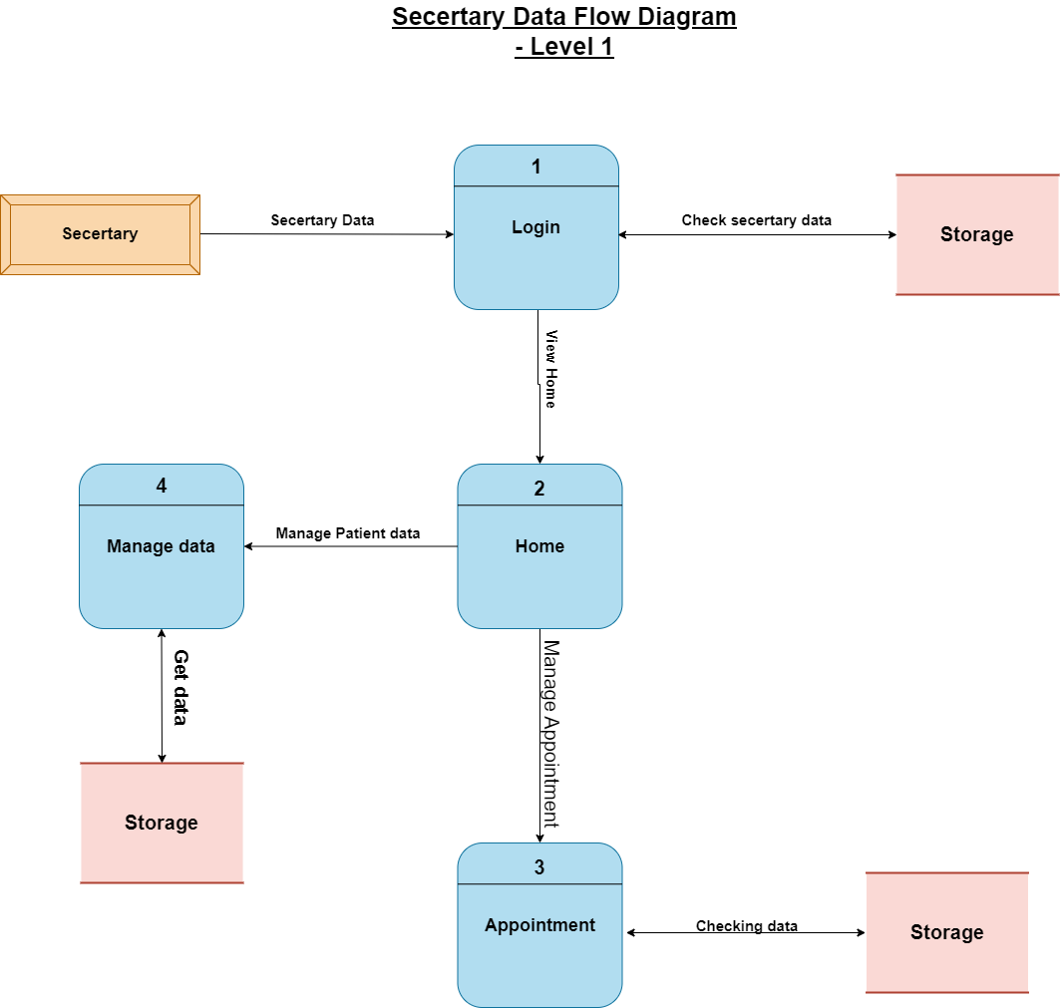
Level 1 (Secretary )

Slide 23
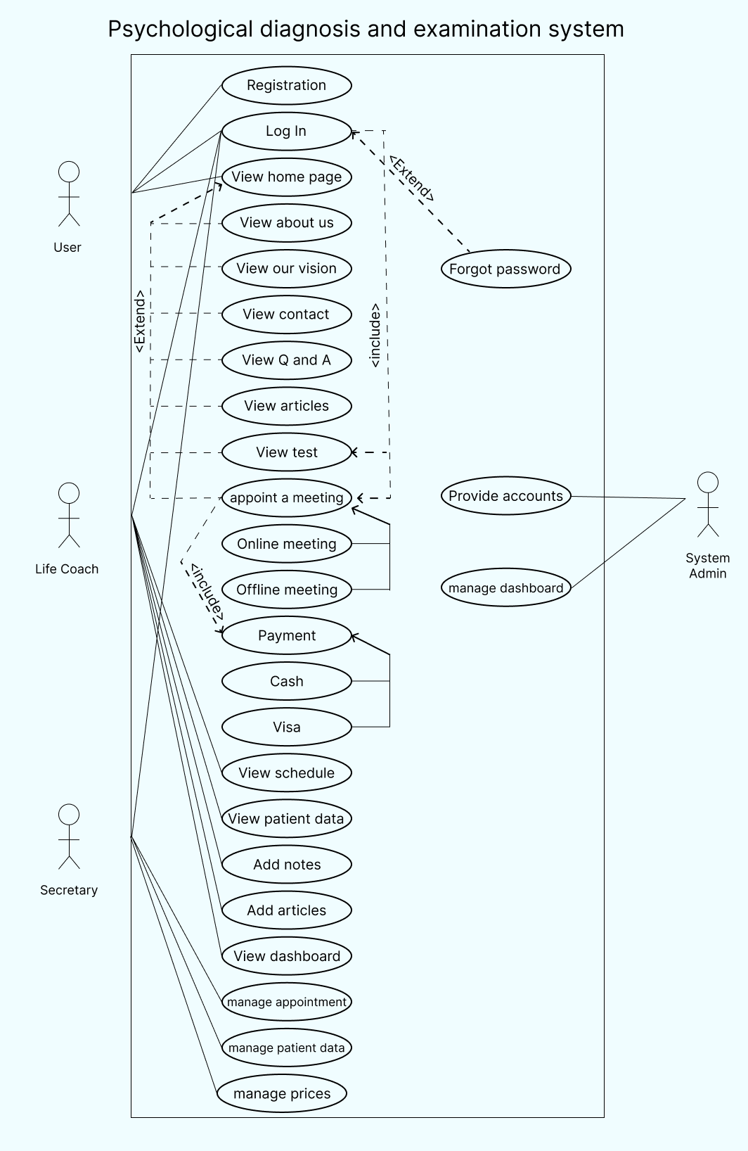
Use Case Diagram

Slide 24
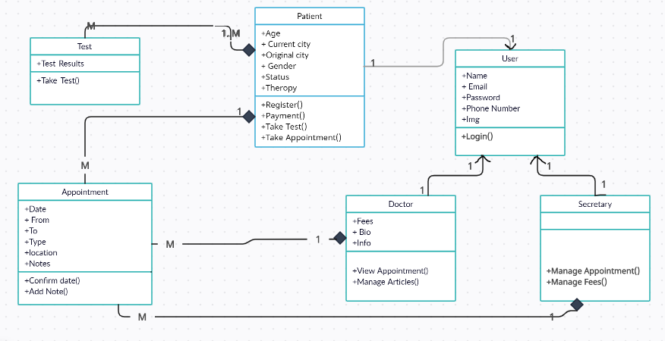
Class Diagram

Slide 25
Design Phase

Slide 26


Design Phase
System Architecture
Database Design
UI & UX Design

Slide 27

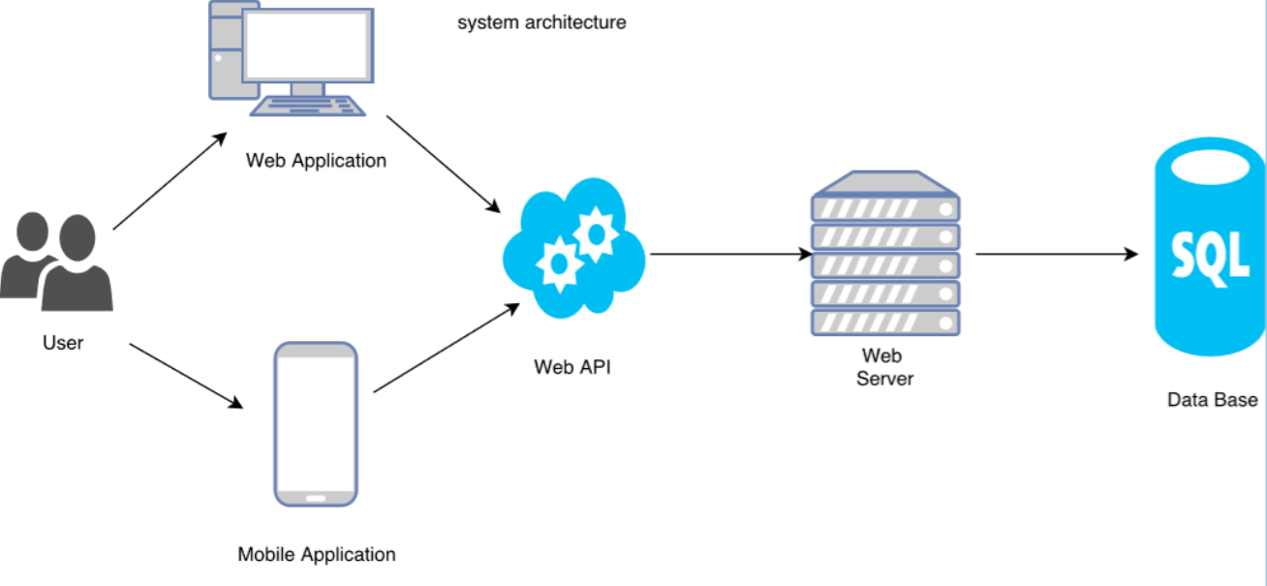

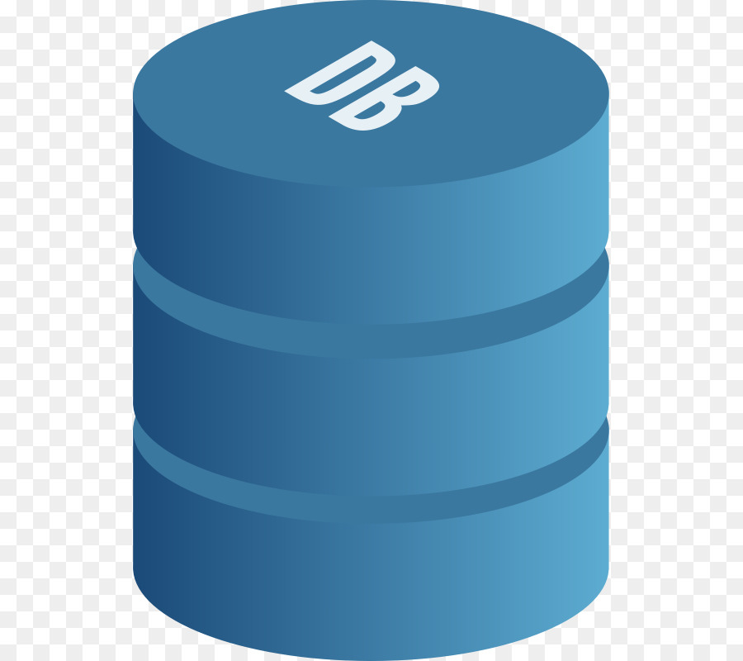
System Architecture
Front-End
Back-End
Patient
Doctor
Web
Application
Secretary
Web API
Web Server
Data Base
Doctor
Mobile
Application

Slide 28
Database Design
ERD Design
Schema

Slide 29
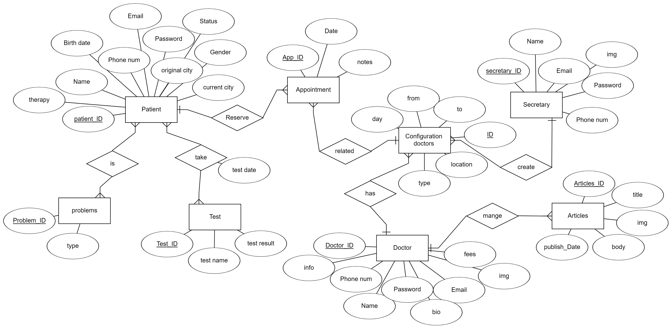
ER-Diagram

Slide 30
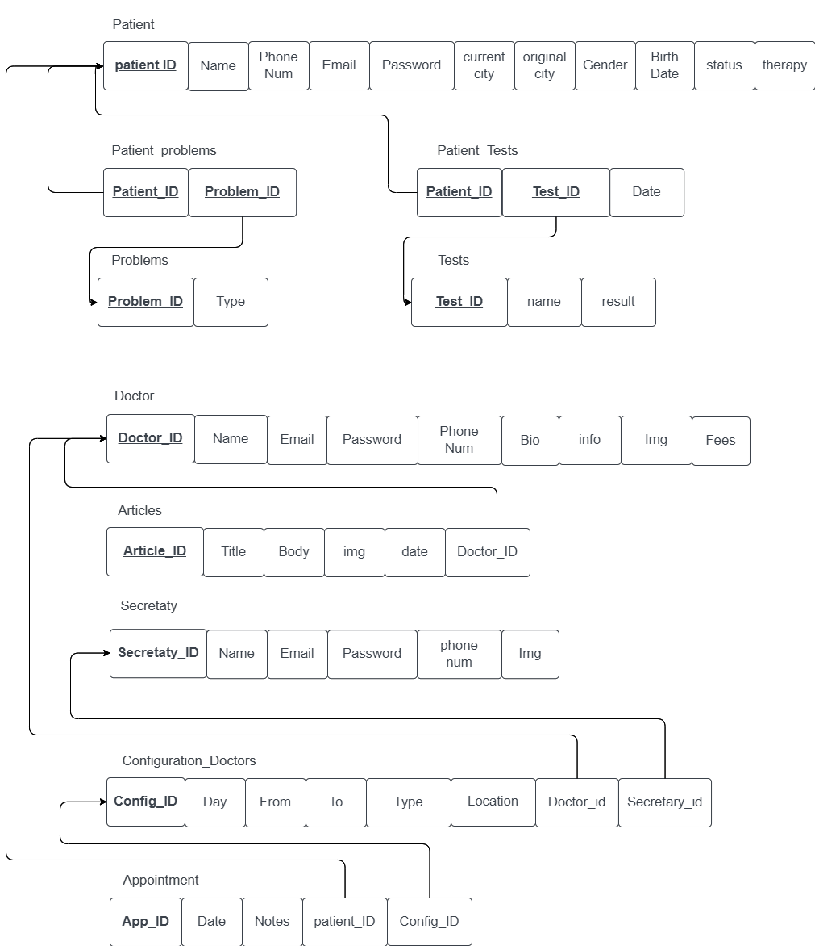
Schema

Slide 31
UI & UX Design
Mobile Design
Website Application Design

Slide 32

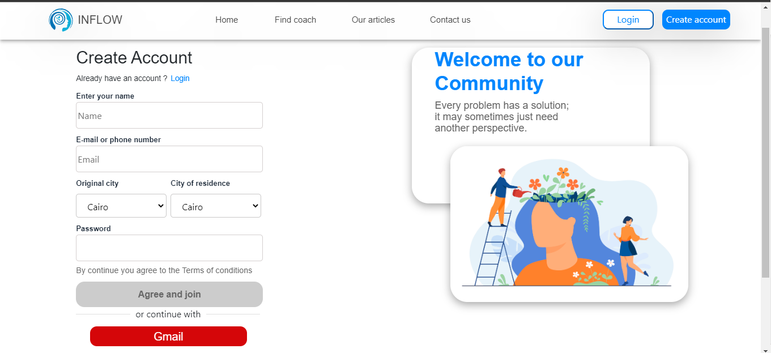
Sign-up page
Where user can make new account

Slide 33
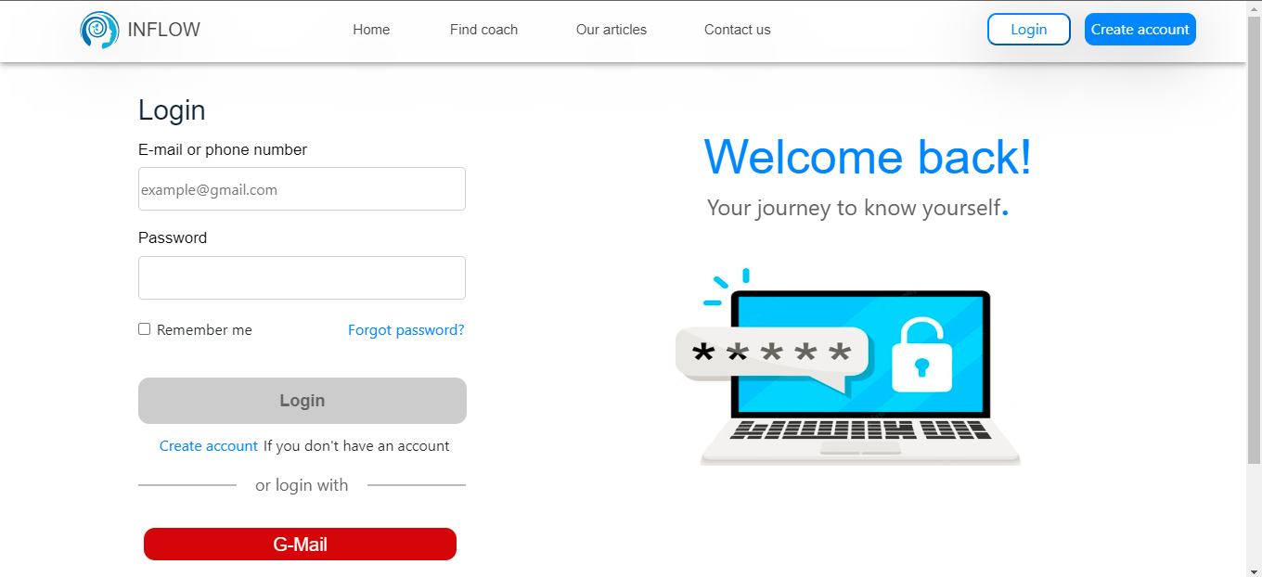
Login page
Where user can verify his identity

Slide 34
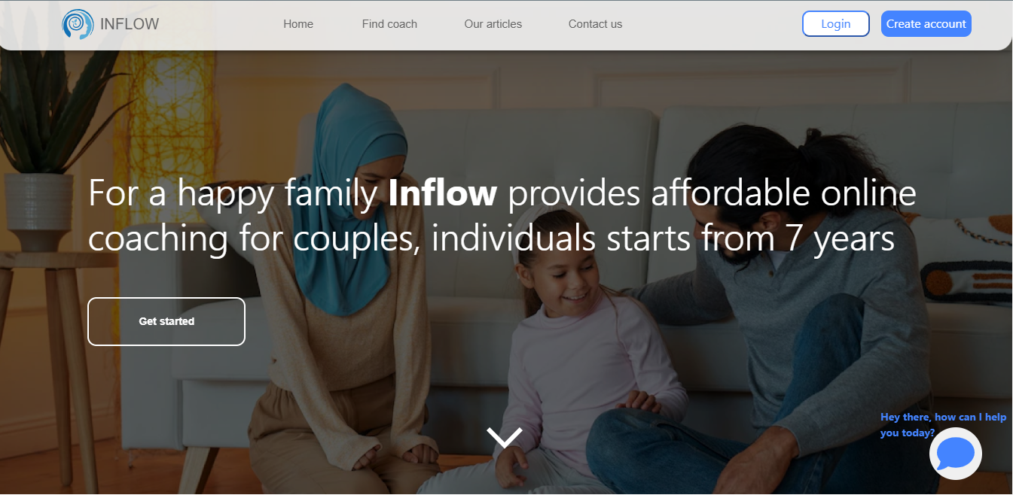
Home page
Where user can view what we really offer in our system

Slide 35
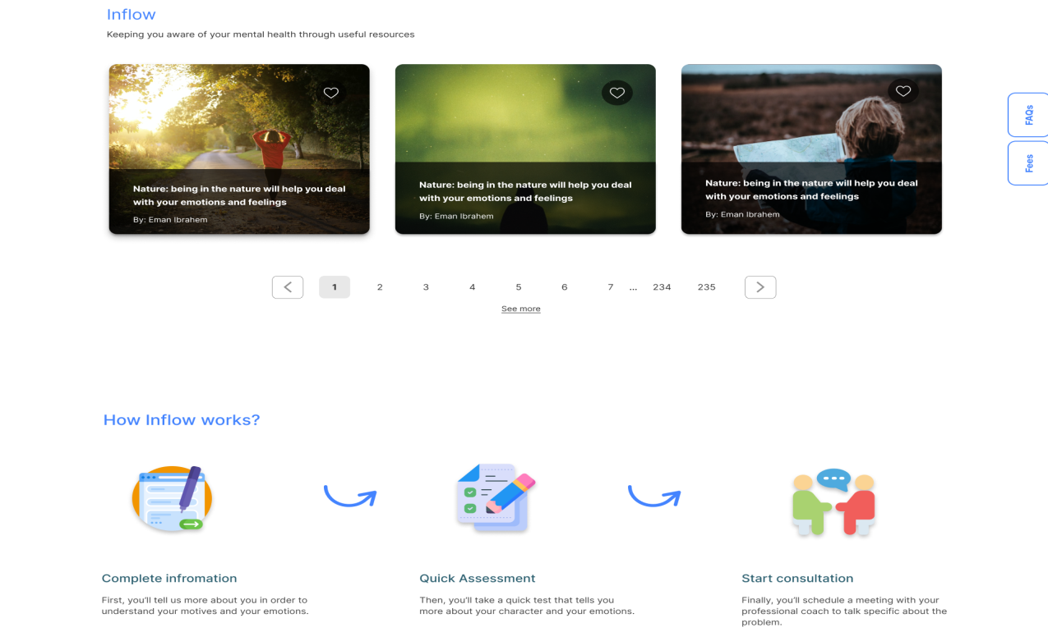
Home page
Where user can view what we really offer in our system

Slide 36
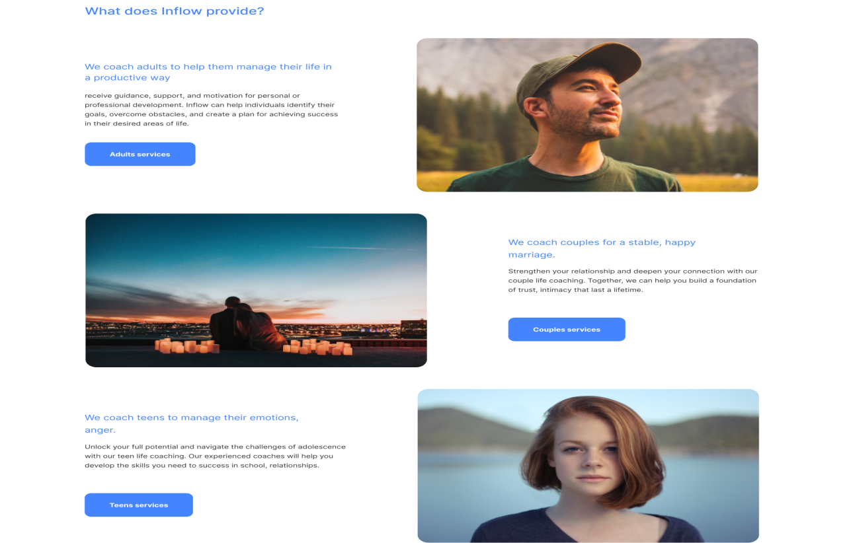
Home page
Where user can view what we really offer in our system

Slide 37
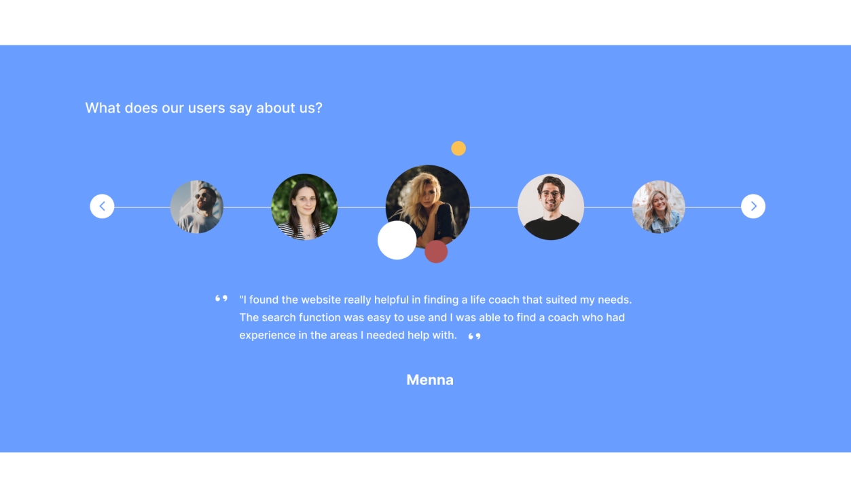
Home page
Where user can view what we really offer in our system

Slide 38
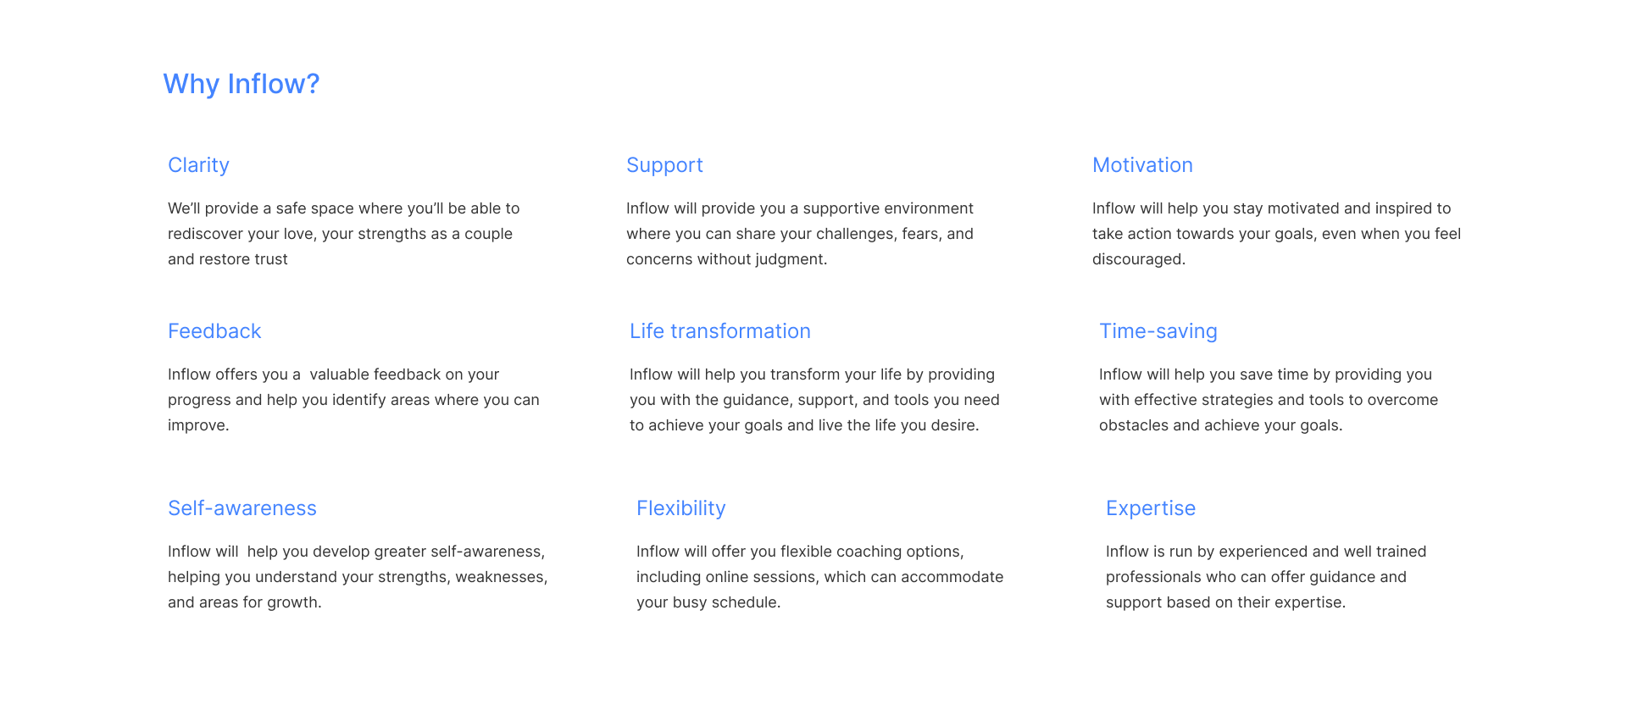
Home page
Where user can view what we really offer in our system

Slide 39
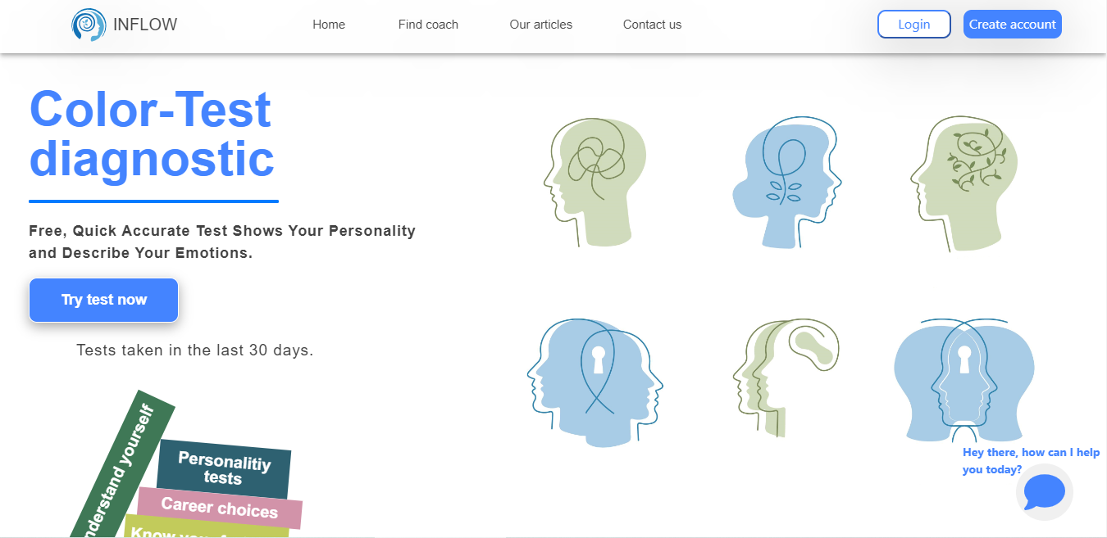
Test home page
Where user gets to know about test and its advantages.

Slide 40
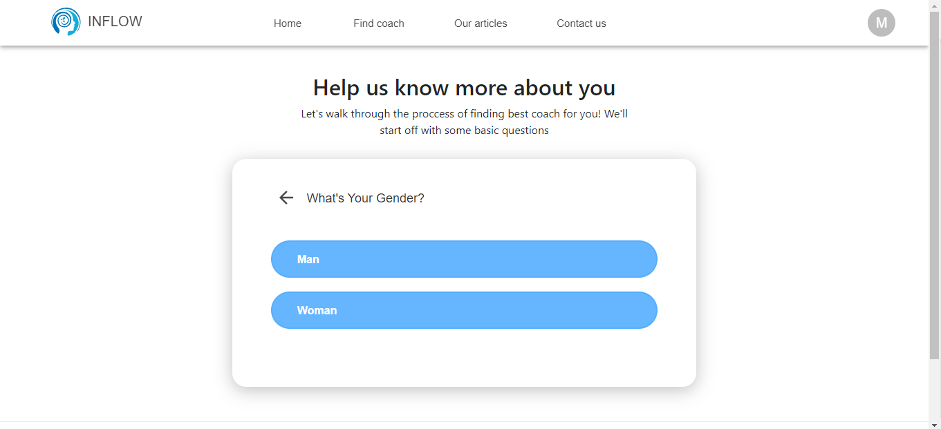
Form page
Where user fill information required by system before entering the test.

Slide 41
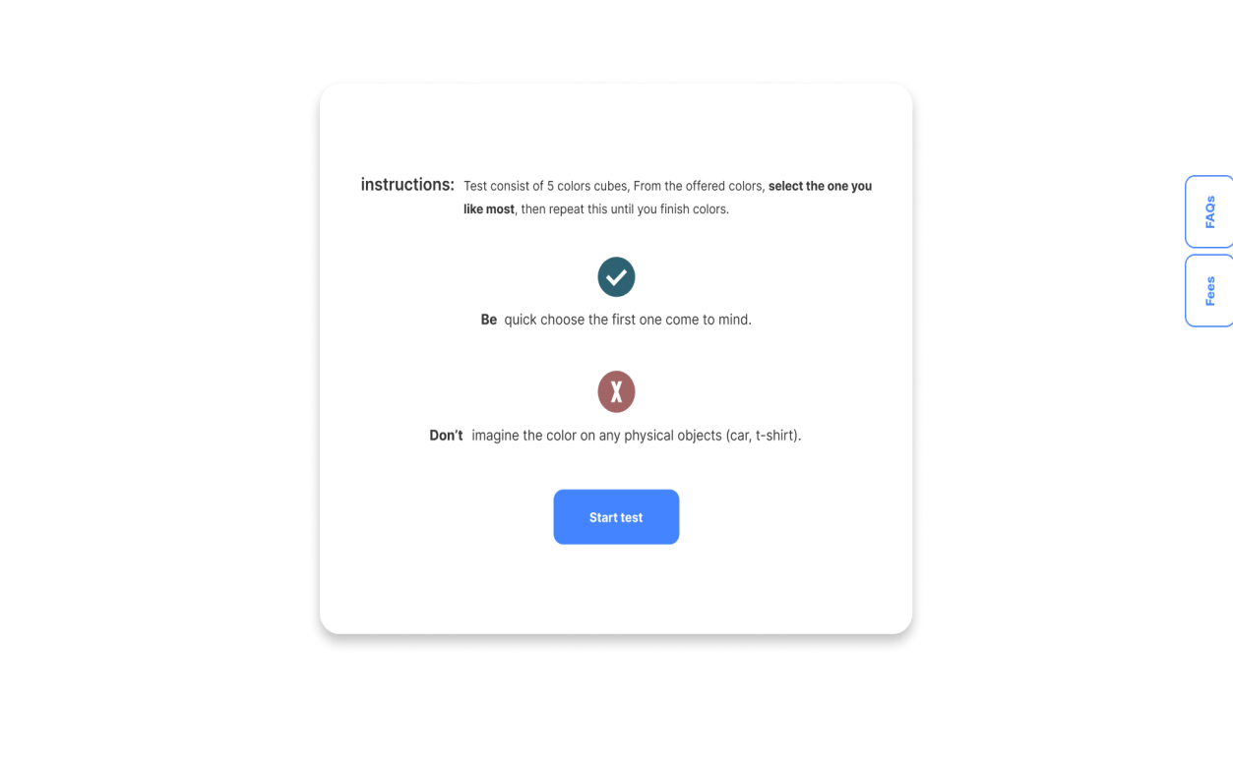
Test instructions page
Where user know the instruction for clear test results.

Slide 42

Test page
Where user should arrange colors from what he likes to what he dislikes.

Slide 43
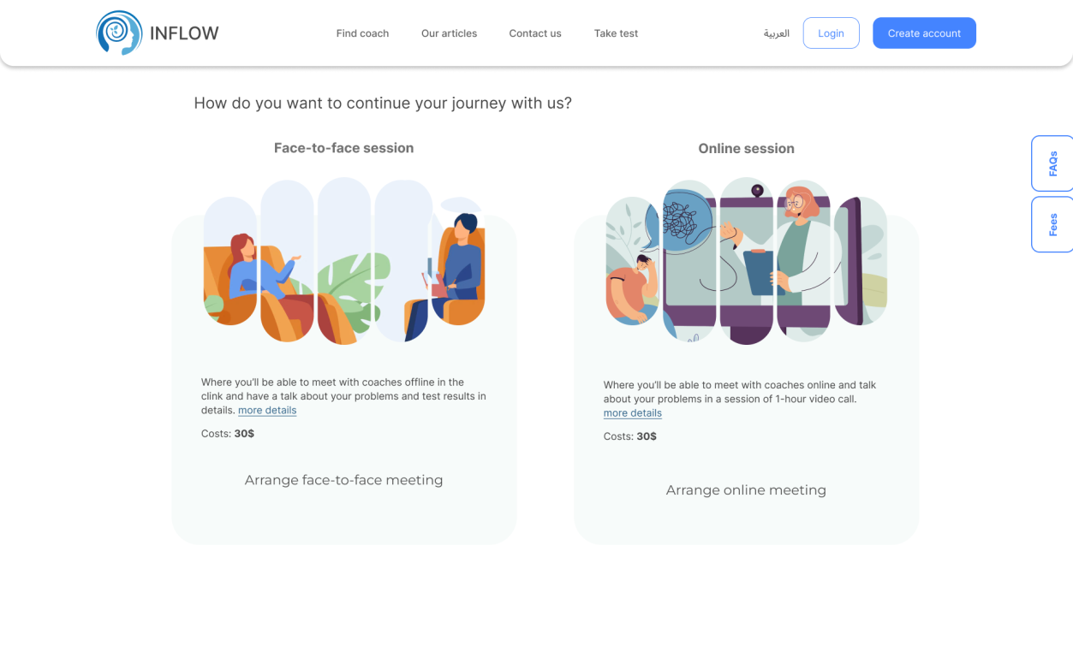
Meeting test page
Where user should choose from online and offline meeting then choose time

Slide 44
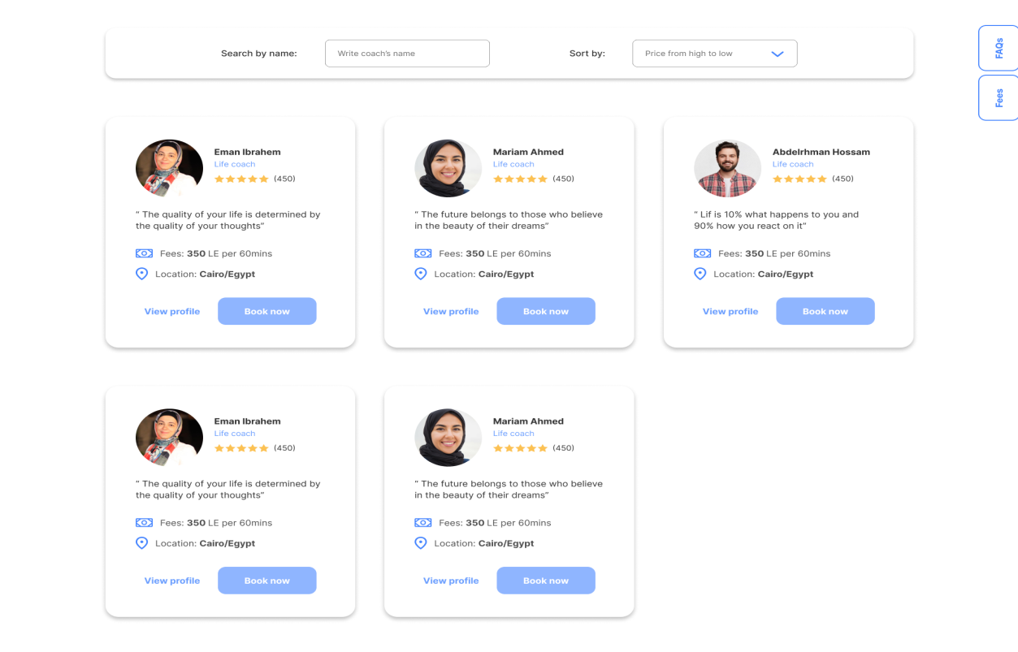
Choosing coach
Where user choose a coach from available coaches

Slide 45
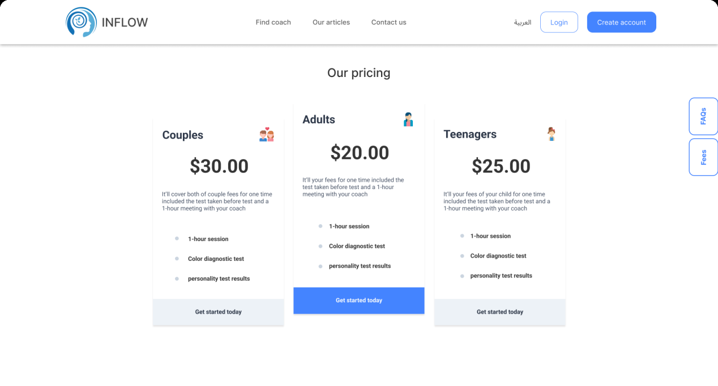
Payment
Where user see available packages for payment

Slide 46
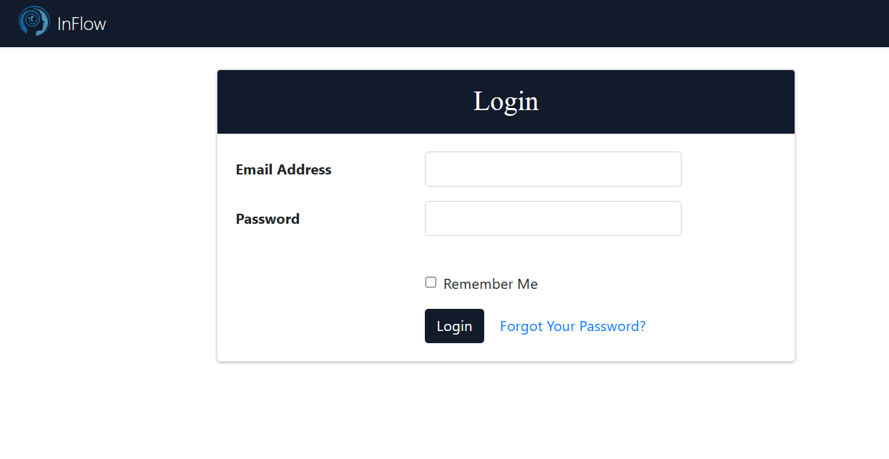
Login page
Where coach can login to her account

Slide 47
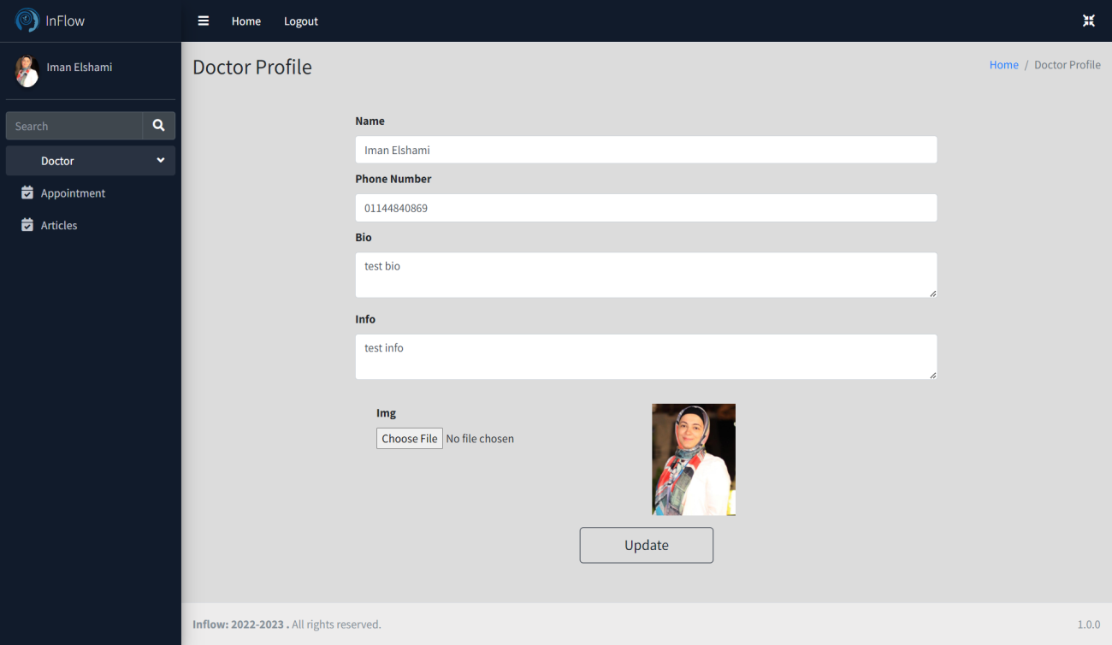
Coach profile
Where can see and edit her information

Slide 48
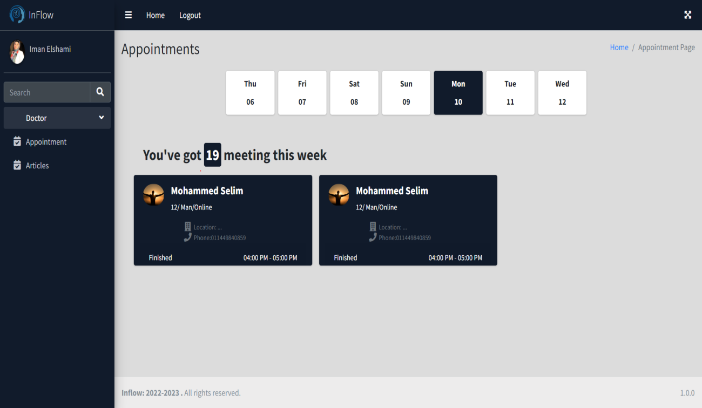
Appointments page
Where coach can see her appointments for the week

Slide 49
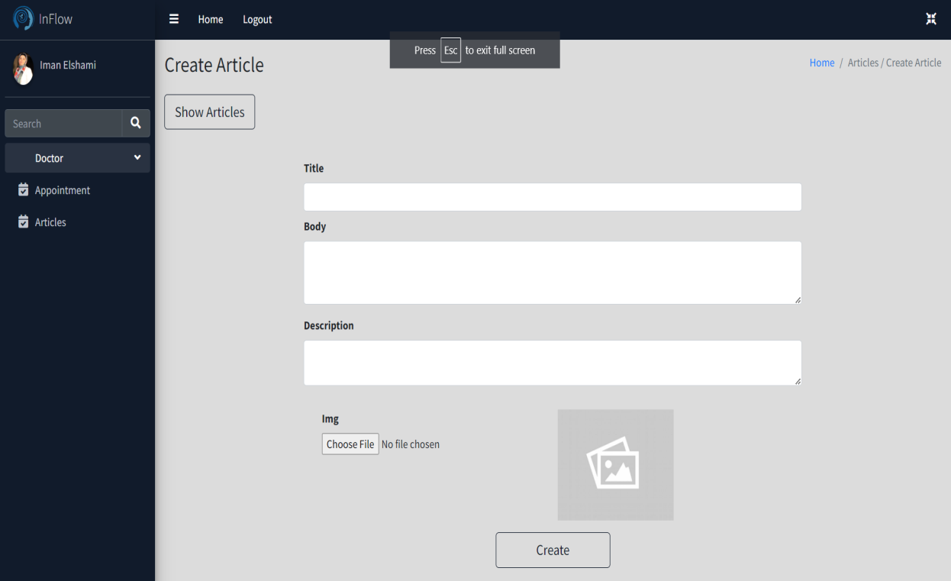
Add articles page
Where coach can add articles

Slide 50
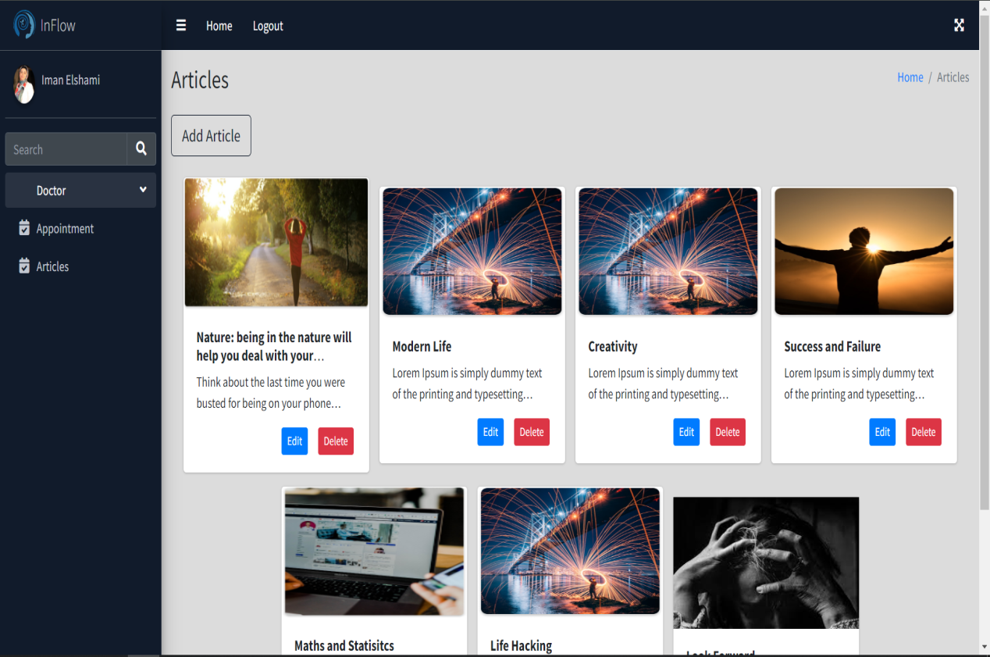
View article page
Where coach can see her articles

Slide 51
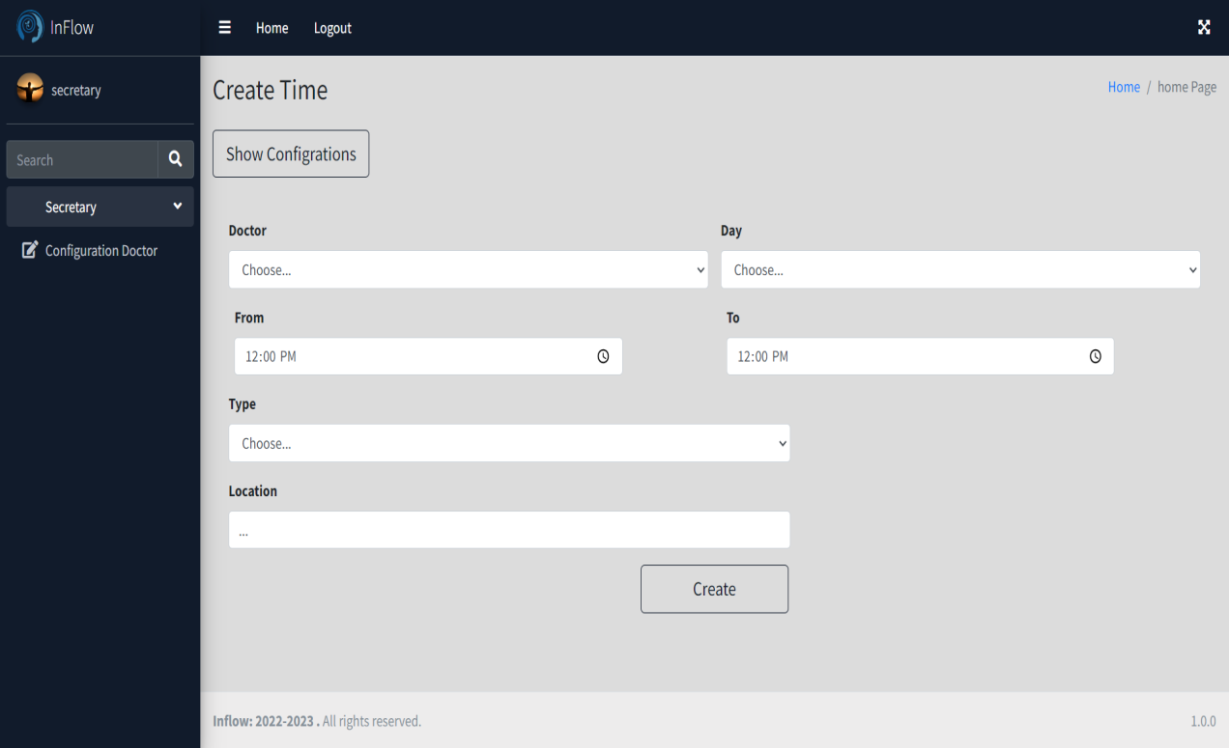
Add appointment page
Where secretary can add appointment

Slide 52
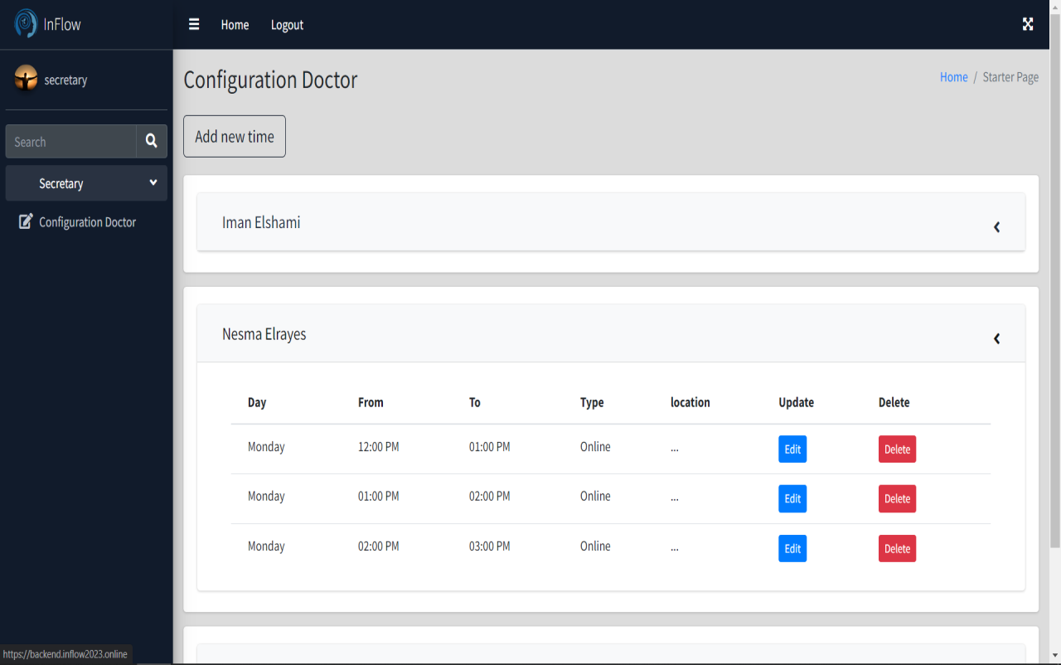
View appointments
Where secretary can view and edit appointments.

Slide 53

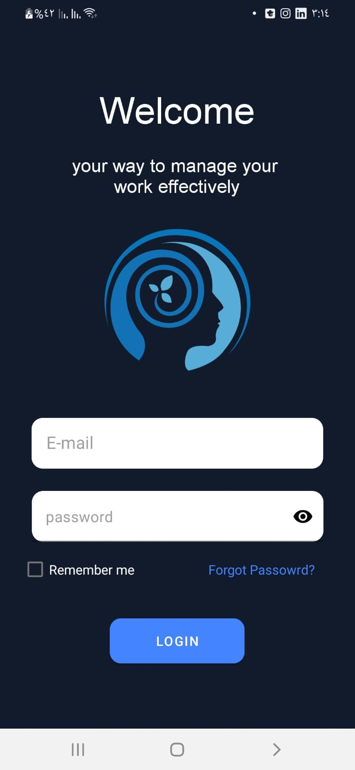
Mobile login page
Where use can log in to our application

Slide 54
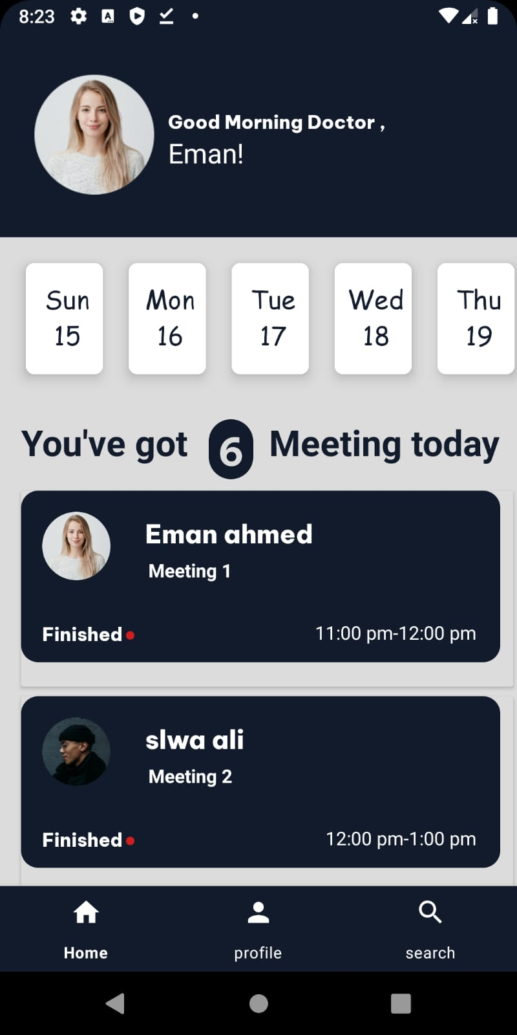
Mobile Home page
Where coach can see all her appointments and users

Slide 55
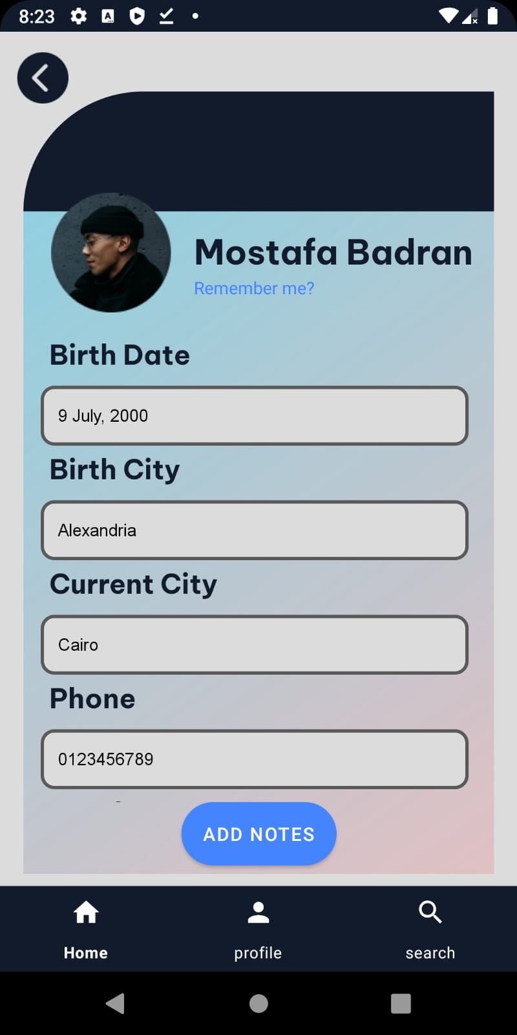
Patient Screen
Where Coach can View Patient Info.

Slide 56
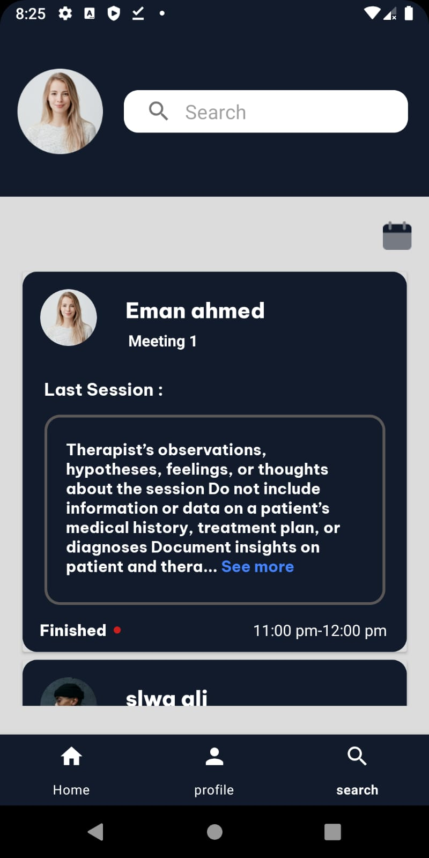
Patient History Screen
Where Coach can View Patient Notes History.

Slide 57
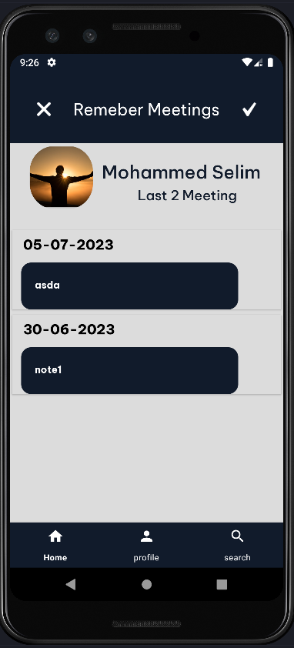
Remember Meetings Screen
Where Coach can View His Meetings.

Slide 58
Implementation

Slide 59
AI Feature & Testing Strategy

Slide 60

AI Feature & Testing Strategy
Chat bot
Data
Analysis
Testing
Strategy

Slide 61

AI Feature (Chat bot)
A chatbot is a computer program that simulates human conversation through voice commands or text chats or both
it’s an artificial intelligence (AI) feature that can be embedded and used through any major messaging application.
Benefits of Chatbot:
24/7 Availability.
Instant response.
Order without human touching.
Personalization.
Multilingual.

Slide 62
Data Analysis
Data analysis is the process of collecting, modeling, and analyzing data using various statistical and logical methods and techniques..
The benefits of Data analysis include Inform business decision-making , Identification of potential risks and target customers better.
Process of Data Analytics:
Define why you need data analysis.
Collecting Data.
Cleaning Data.
Analyzing the Data.
Taking a decision based on the results and apply them.

Slide 63
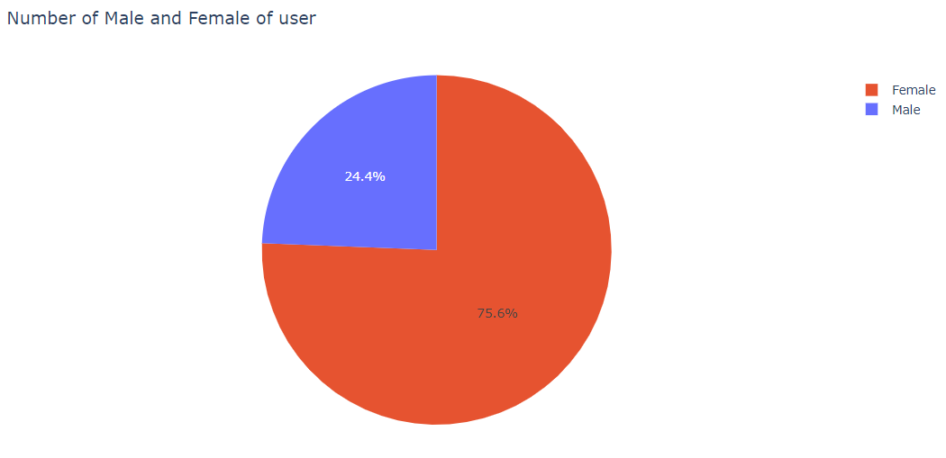
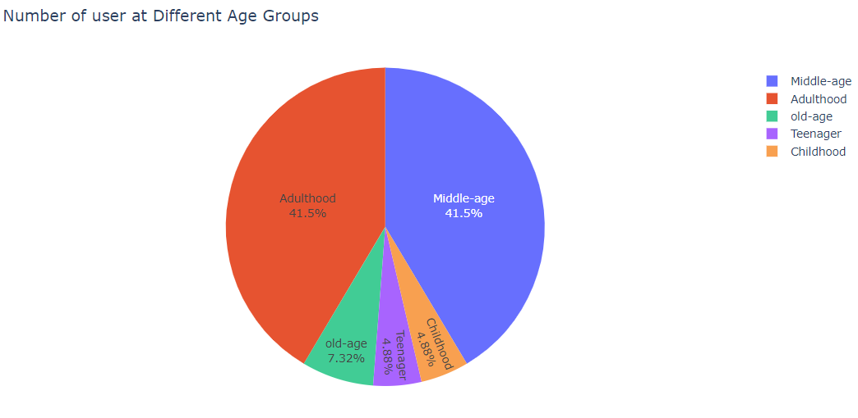
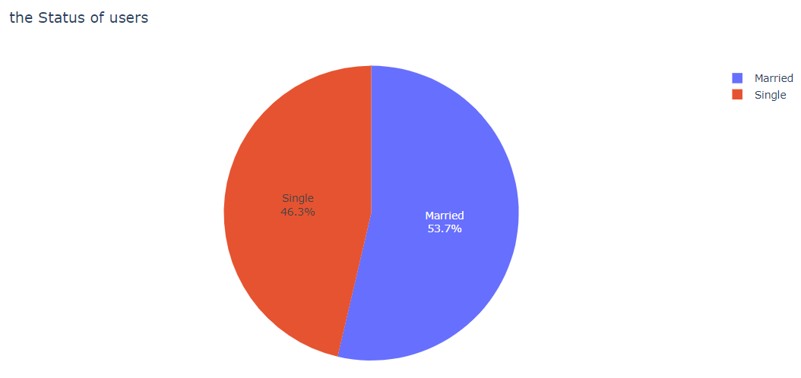
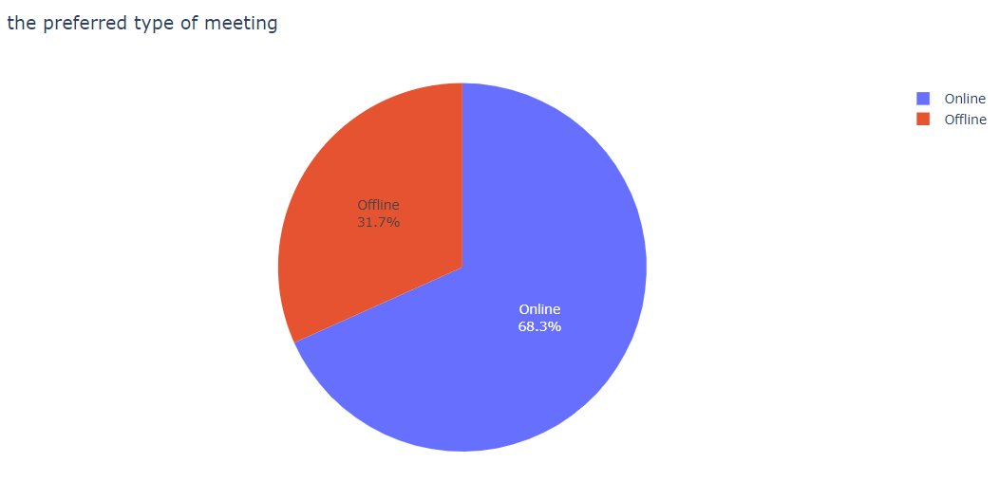
Most Important Insights

Slide 64
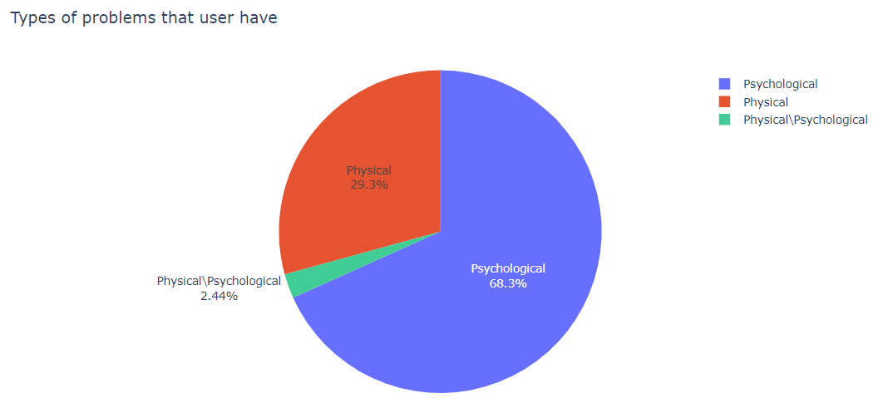
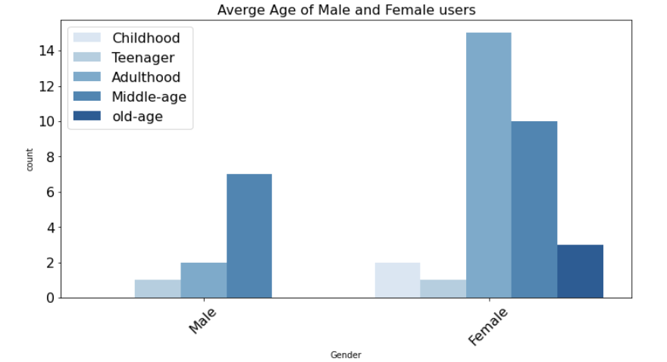
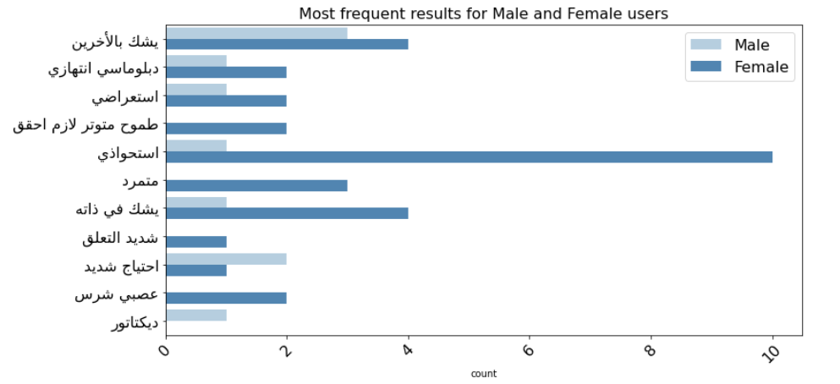
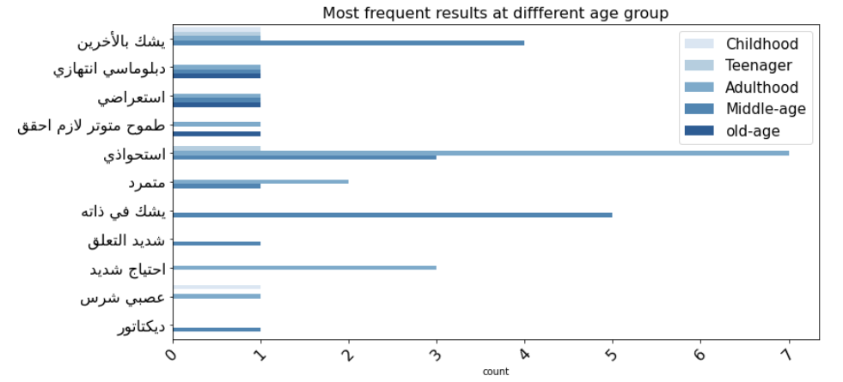

Slide 65
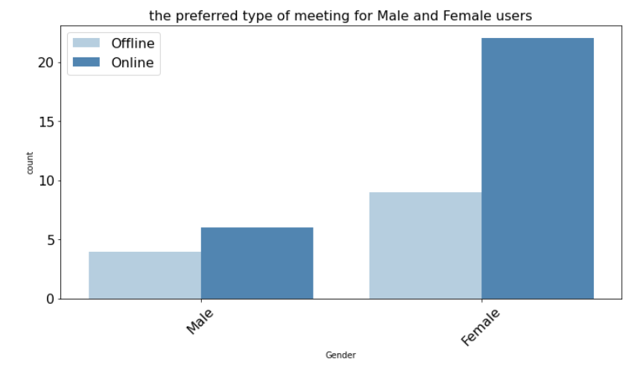
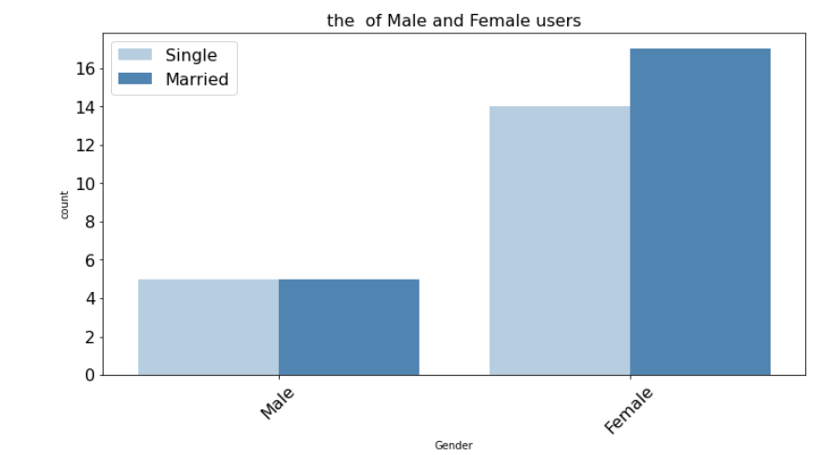
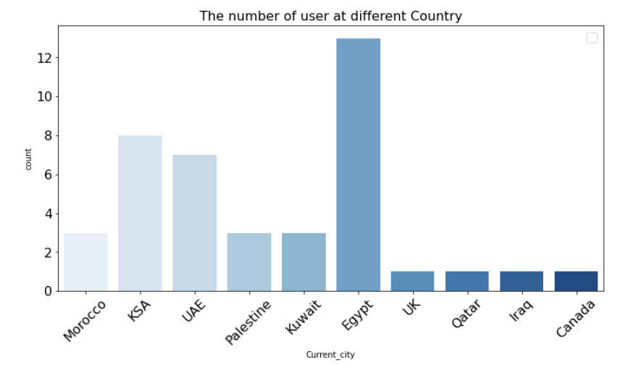

Slide 66
Testing Strategy
Testing is intended to show that a program does, what it is intended to do and to discover program defects before it is put into use.
The benefits of testing include preventing bugs, reducing development cost and improving performance.
Level of testing:
Unit Testing
Integration Testing
System Testing
Acceptance Testing

Slide 67

Penetration Testing
Penetration testing: is a security assessment technique performed on computer systems, networks or web applications to identify and exploit vulnerabilities that could potentially be exploited by malicious attackers.
The goal of penetration testing is to simulate real-world attack scenarios in a controlled manner to assess the security posture of a system or organization.
Benefits of Penetration Testing:
Identifying vulnerabilities.
Mitigating risks.
Validating security controls.
Improving incident response.
Building customer trust.

Slide 68
Future Work!

Slide 69
Any Questions!

Slide 70
Thanks !

